Slide 1





DCAI
DATA CENTRIC AI
Name | PRN | Roll Number
Chetan Gorkshanath Kotangale | 22310226 | 211009
Atharva Vinayak Maslekar | 22310981 | 211037
Atharva Rajendra Joshi | 22311496 | 211049
Manas Girish Kulkarni | 22311608 | 211058
Prediction of Diabetes Using Machine Learning
SCE Presentation

Slide 2
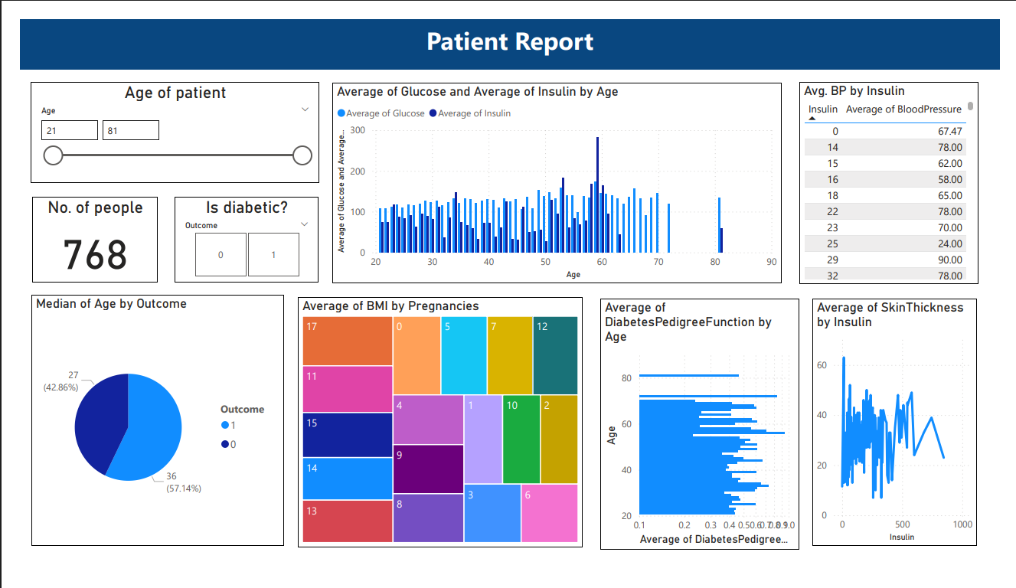
POWER BI DASHBOARD

Slide 3
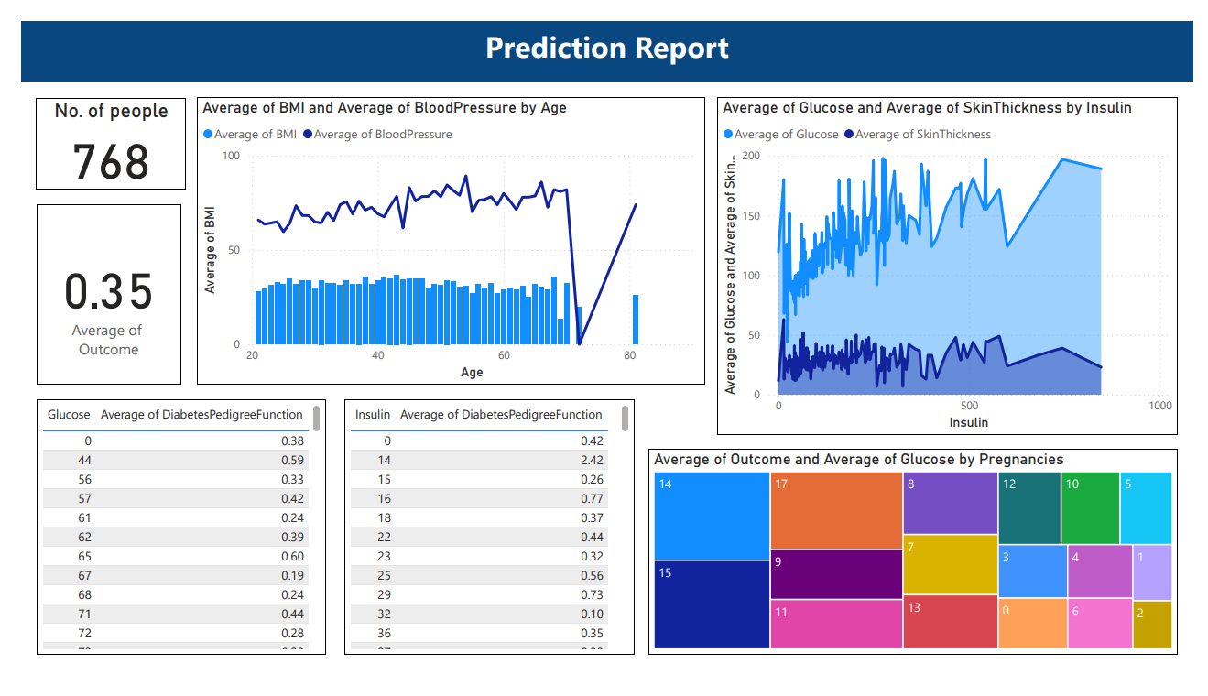
POWER BI DASHBOARD

Slide 4


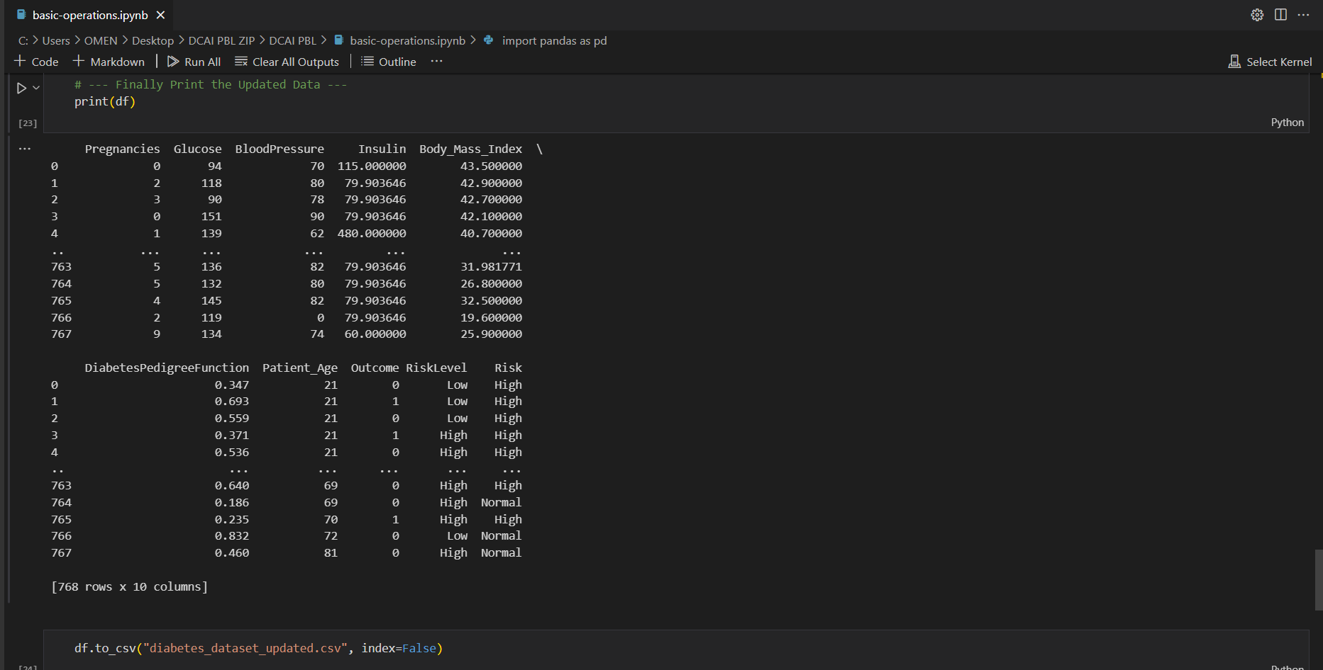


BASIC OPERATIONS

Slide 5


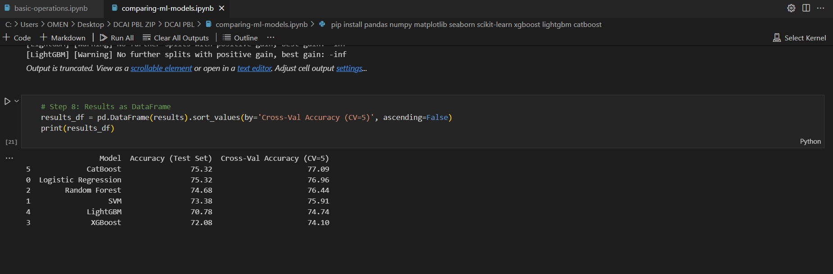
COMPARING ML MODELS

Slide 6
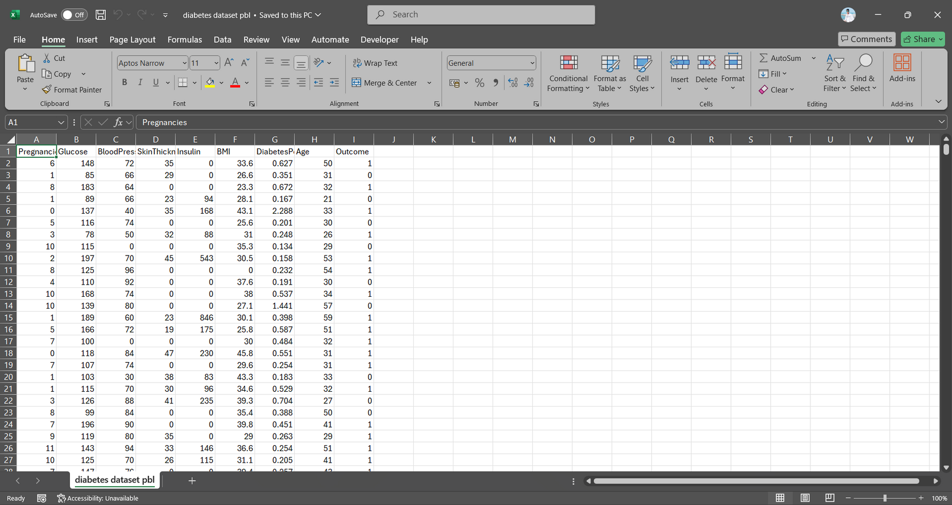
DATASET

Slide 7
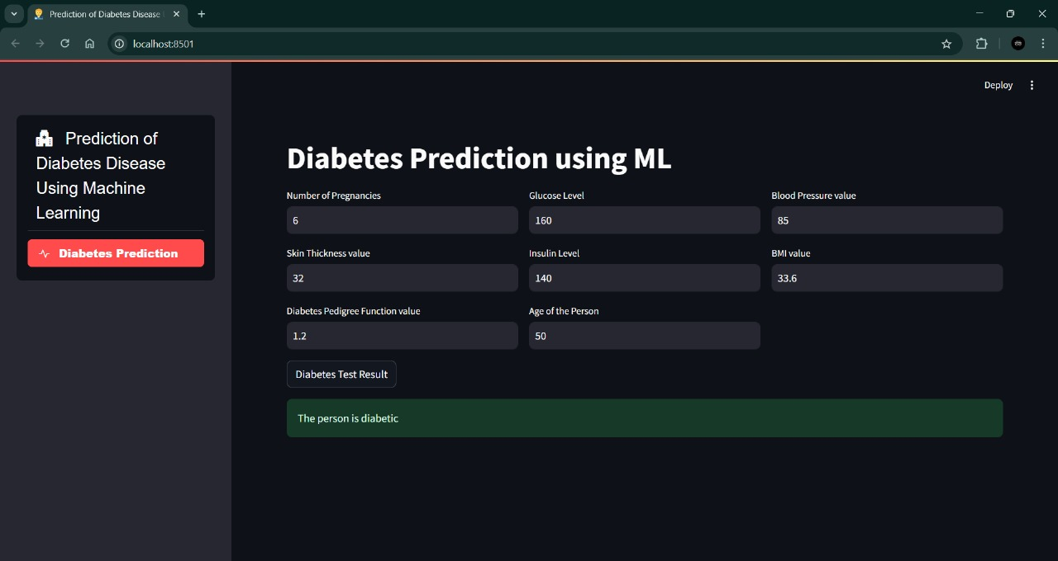
ML Model (For Diabetic)

Slide 8

ML Model (For Non-Diabetic)

Slide 9
CONCLUSION
The diabetes analytics project demonstrates how data visualization and basic machine learning techniques can uncover meaningful health insights. By analyzing key attributes like glucose levels, insulin, BMI, and pedigree function, we can observe distinct patterns that correlate strongly with diabetic outcomes. Power BI's visual capabilities played a crucial role in making these patterns more interpretable, while the use of ML models provided a predictive angle to the study.

Slide 10




Thank You
Atharva Maslekar
atharva.22310981@viit.ac.in
22310981/211037
7719097941
Atharva Joshi
atharva.22311496@viit.ac.in
22311496/211049
9527043551
Manas Kulkarni
manas.22311608@viit.ac.in
22311608/211058
7972470825
Chetan Kotangale
chetan.22310226@viit.ac.in
223110226/211009
8055409952

